Slide 1




JOB SEARCH

Slide 2
MINOR PROJECT
Project Name:-Job Portal Mentor:-Dr. Sanjay Sharma
BY: Manish Kumar
Mayank Khichi
Kanisth Gupta

Slide 3
Description:
JobBridge is a user-friendly website that connects job seekers and Companies easily. We use smart technology to help job seekers find the right jobs and Companies to post job listing. Our website is safe and fast, so your data is secure, and you can quickly find what you need. Join us now for a smooth job search and hiring experience!

Slide 4


Agenda
1.User-Friendly Job Search 2.Personalized Job Recommendations
User Registration and Profiles
Job Application Management
Job Posting
User Preferences
Detailed Company Profiles 8.Real-time Notifications
Page 04

Slide 5


Project OverView:-
ADMIN:-
Admin manage and verify Hr
Admin manage and verify Job
Admin can verify message
Admin receive Feedback
Page 05

Slide 6





JOB SEEKER:-
Job Seeker can watch available jobs
Job Seeker upload details
Job Seeker Filter jobs according to his preference
Job Seeker Can Apply for Jobs
Job Seeker Can Message (if he’s message valided by Admin)
Job Seeker Can Feedback
Page 06

Slide 7

RECRUITER:-
Recruiter post their details for verification
Recruiter post their Company Details
Recruiter post Available vacancies in their company
Recruiter can watch Total number Application
Page 07

Slide 8
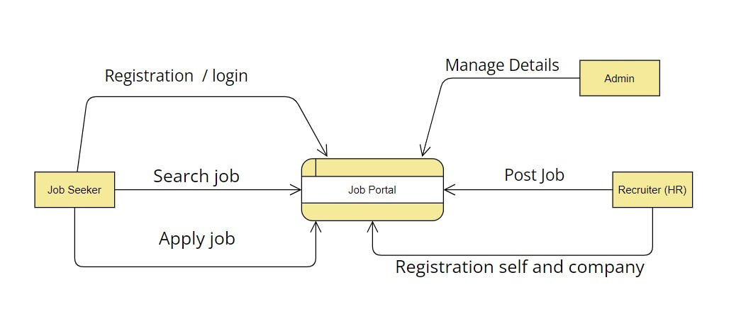
Data Flow Diagram
Page 08

Slide 9
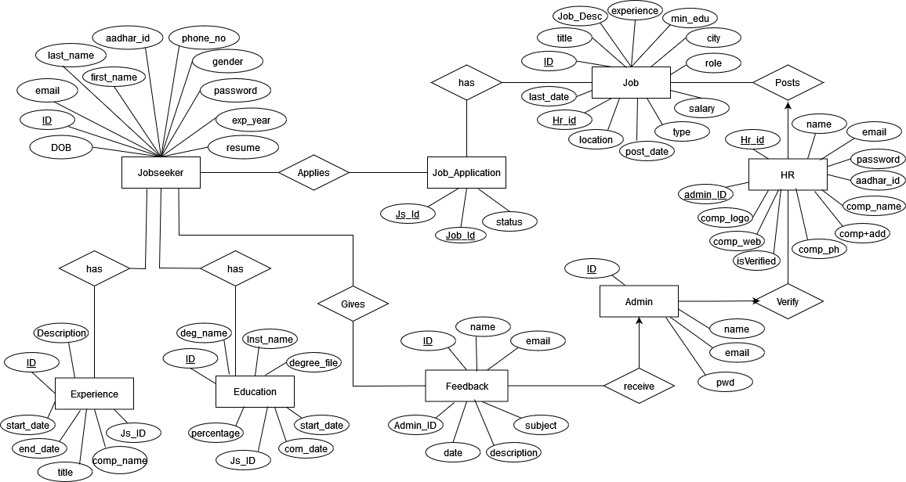
E-R Diagram
Page 09

Slide 10
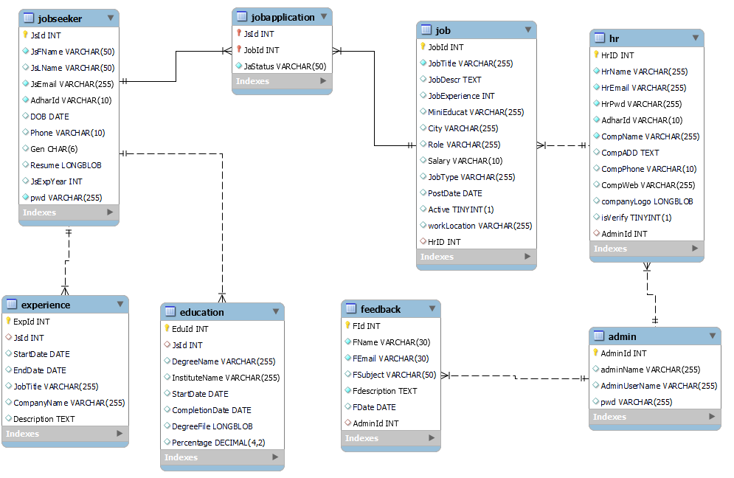
Schema

Slide 11
DataBase

Slide 12
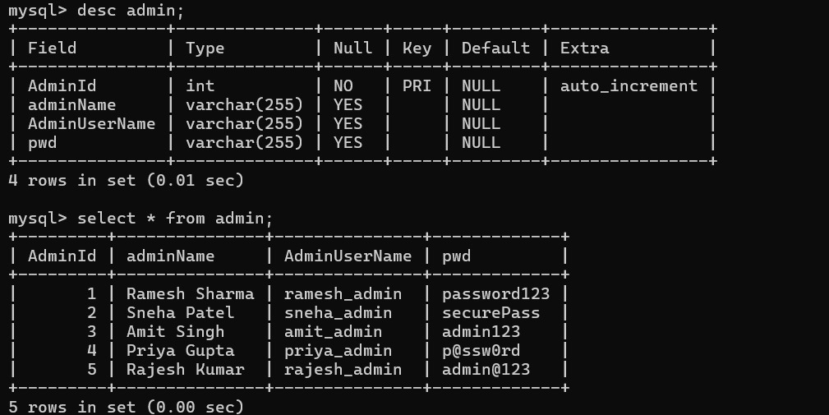
Admin Table:-
2NF

Slide 13
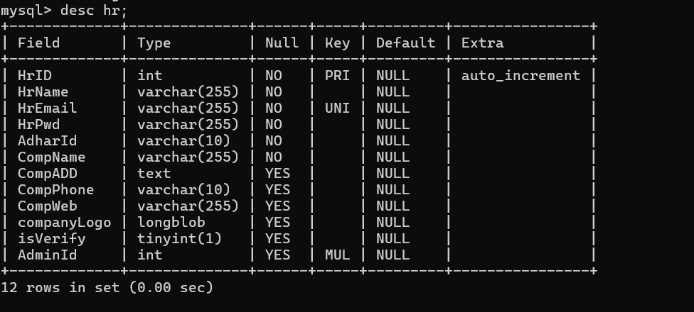

HR Table:-
2NF

Slide 14
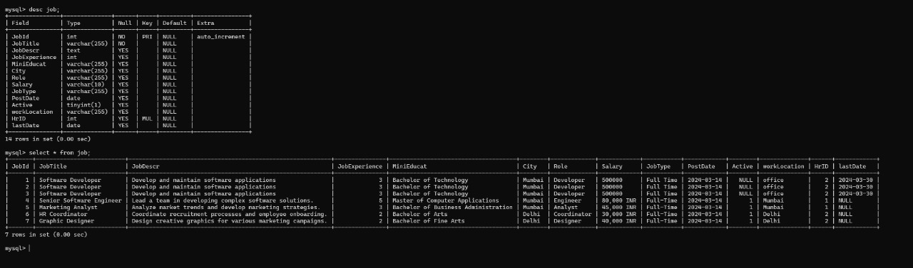
Job Table:-
2NF

Slide 15
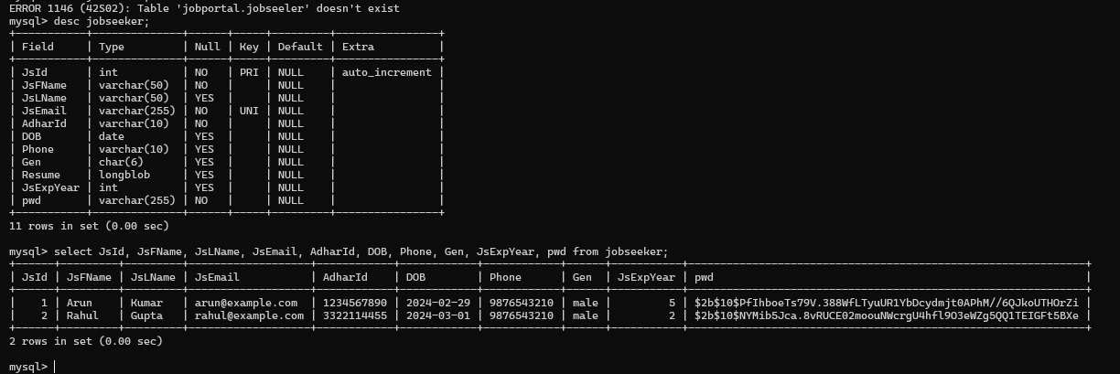

Job Seeker Table:-
2NF

Slide 16
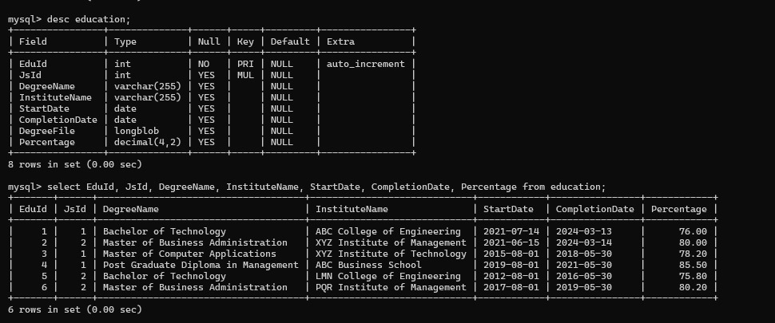

Education Table:-
2NF

Slide 17
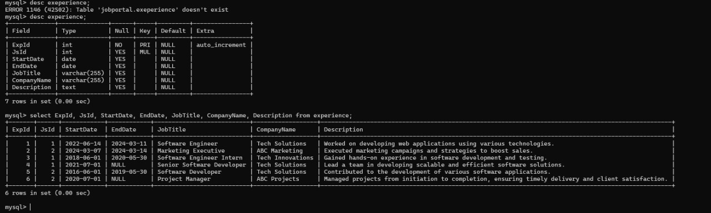

Experience Table:-
2NF

Slide 18
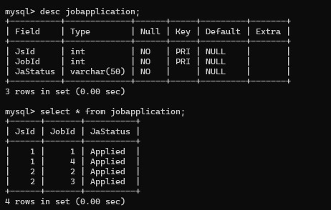
Job Applicaton Table:-
2NF
Job Search Strategy

Slide 19
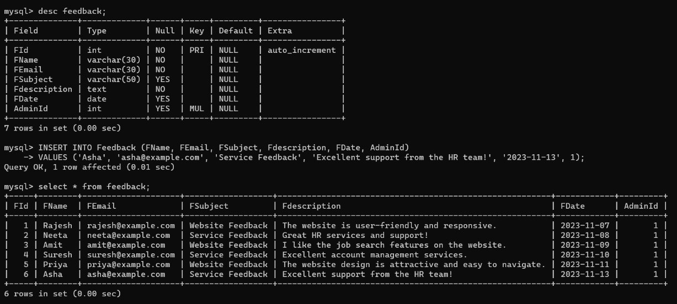


Feedback Table:-
2NF

Slide 20
Functional Dependencies
Admin Table:
AdminId -> AdminUserName AdminId -> pwd
HR Table:
HrID -> HrName, HrEmil, HrPwd, AdharId, CompName, CompADD, CompPhone, CompWeb, CompLogo, Admin
HrEmil -> HrID
AdminId -> HrID
JobSeeker Table:
JsId -> JsFName, JsLName, JsEmail, AdharId, pwd, DOB, Phone, Gen, Resume, JsExpYear JsEmail -> JsId
Job Table:
JobId -> JobTitle, JobDescr, JobExperience, MiniEducat, City, Role, Salary, JobType, PostDate, LastDate, workLocation , HrID
HrID -> JobId

Slide 21
Functional Dependencies
Job Application Table:
(JsId, JobId) -> JaStatus JsId -> JobId
JobId -> JsId
Experience Table:
ExpId -> JsId, StartDate, EndDate, JobTitle, CompanyName, Description JsId -> ExpId
Education Table:
EduId -> JsId, DegreeName, InstituteName, StartDate, CompletionDate, DegreeFile, Percentage
JsId -> EduId
Feedback Table:
FId -> FName, FEmail, FSubject, Fdescription, FDate, AdminId AdminId -> FId

Slide 22
Data
Dictionary

Slide 23
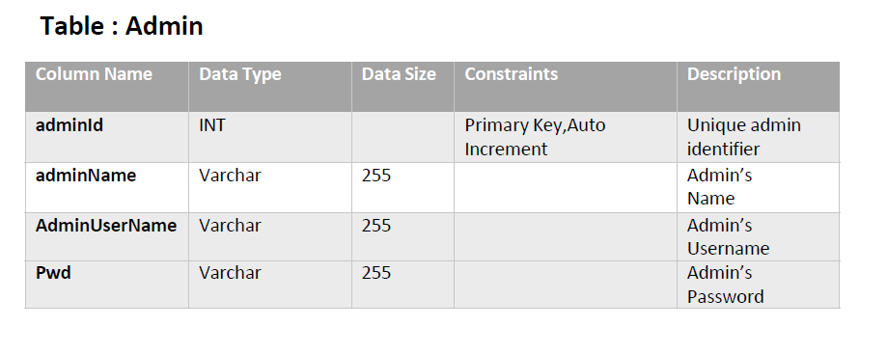

Slide 24
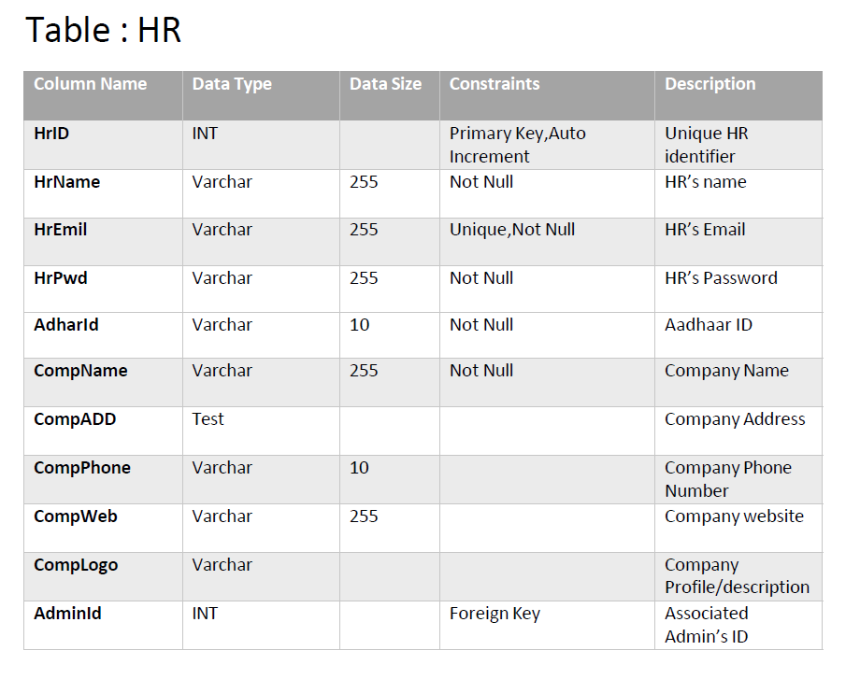


Slide 25
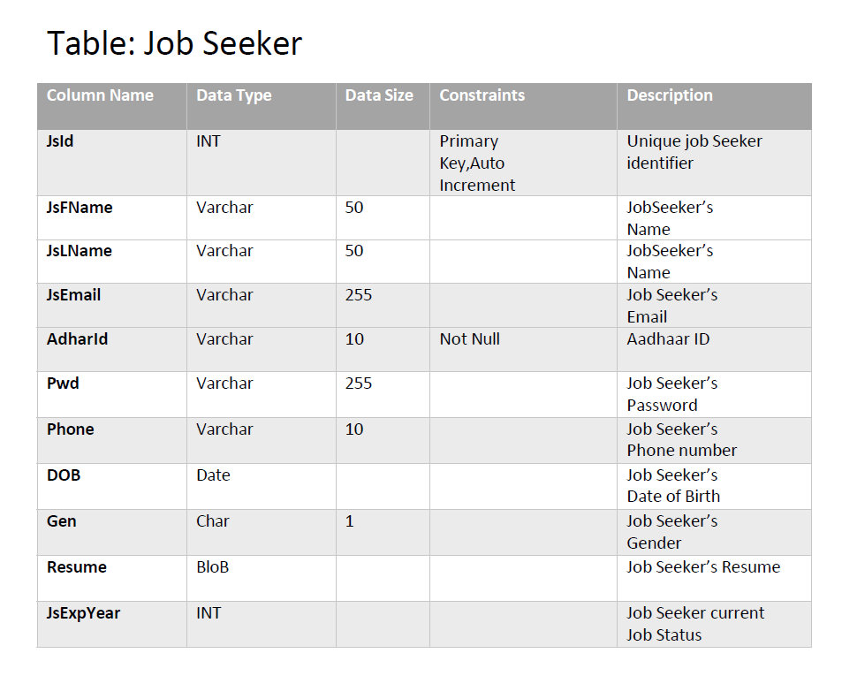


Slide 26
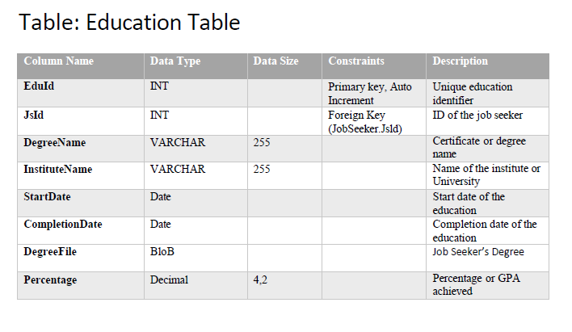


Slide 27
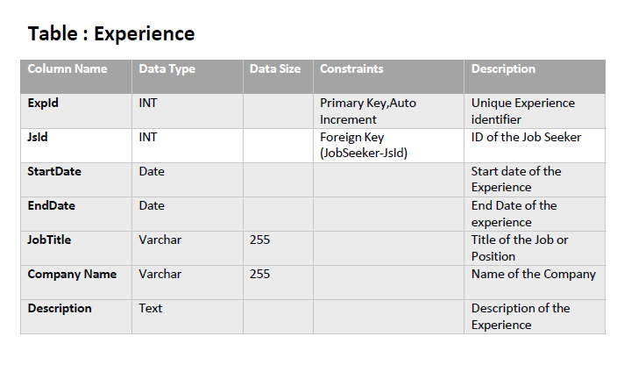


Slide 28
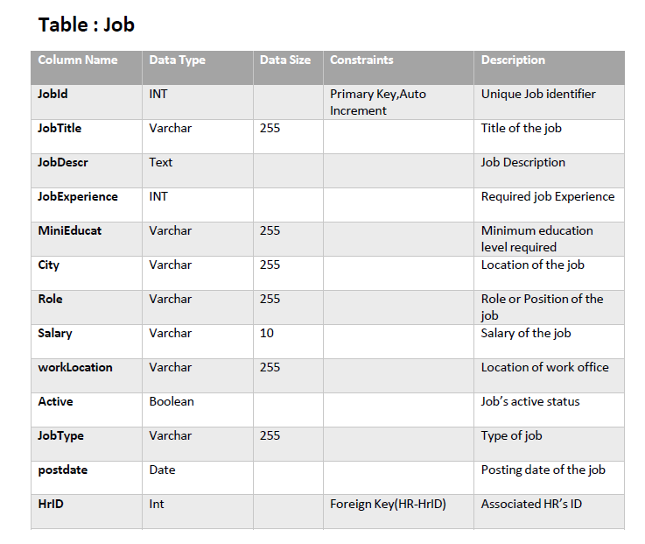

Slide 29
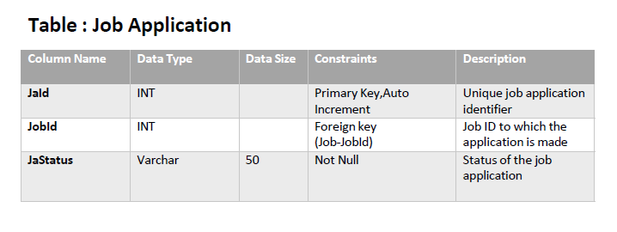

Slide 30
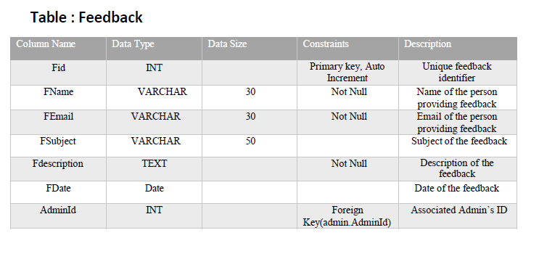


Slide 31
Future Scope:-
Subscription Models
Skills Assessment and Certification
Freelance and Gig Opportunities
Resume/CV Parsing
Learning and Development Resources

Slide 32



